Slide 1
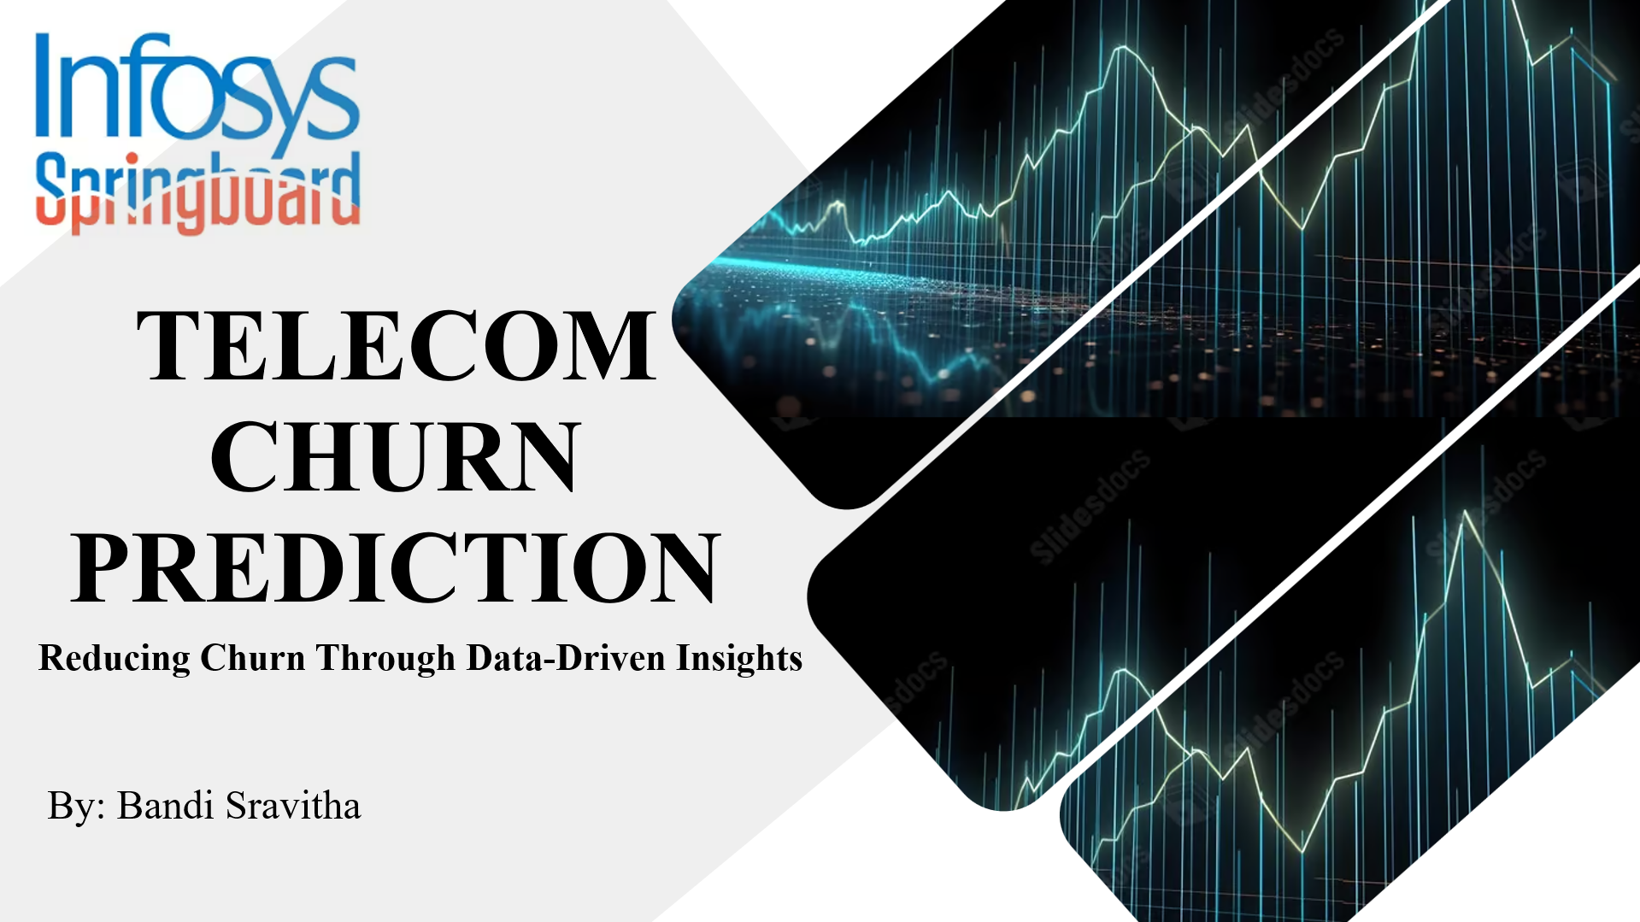

Slide 2


OBJECTIVES
Churn in Telecom Industry
Mission and Vision of Churn Prediction
Goals of Churn Prediction
Challenges in Churn Prediction
Milestones
Data Preprocessing Steps
Machine learning Model Building
Hyperparameter Tuning and ROC Curves
Conclusion

Slide 3

CHURN IN TELECOM INDUSTRY
• Churn refers to the phenomenon where customers discontinue their service with a telecom provider, often switching to a competitor.
• In a Telecom industry customers can choose from multiple service providers and actively switch from one operator to other.
• In this highly competitive market the annual churn rate in telecommunication industry is 15-20%

Slide 4


MISSION OF CHURN PREDICTION
Telecom churn prediction contributes to the overall success and competitiveness of telecom companies in a rapidly evolving market landscape.
VISION OF CHURN PREDICTION
Telecom churn prediction can drive significant improvements in customer satisfaction, business performance, and competitiveness within the telecommunications sector

Slide 5




GOALS OF CHURN PREDICTION
Accurate Prediction
Identifying Key Factors
Enhance Customer Experience
Identifying Key Factors
Enhance Customer Experience

Slide 6

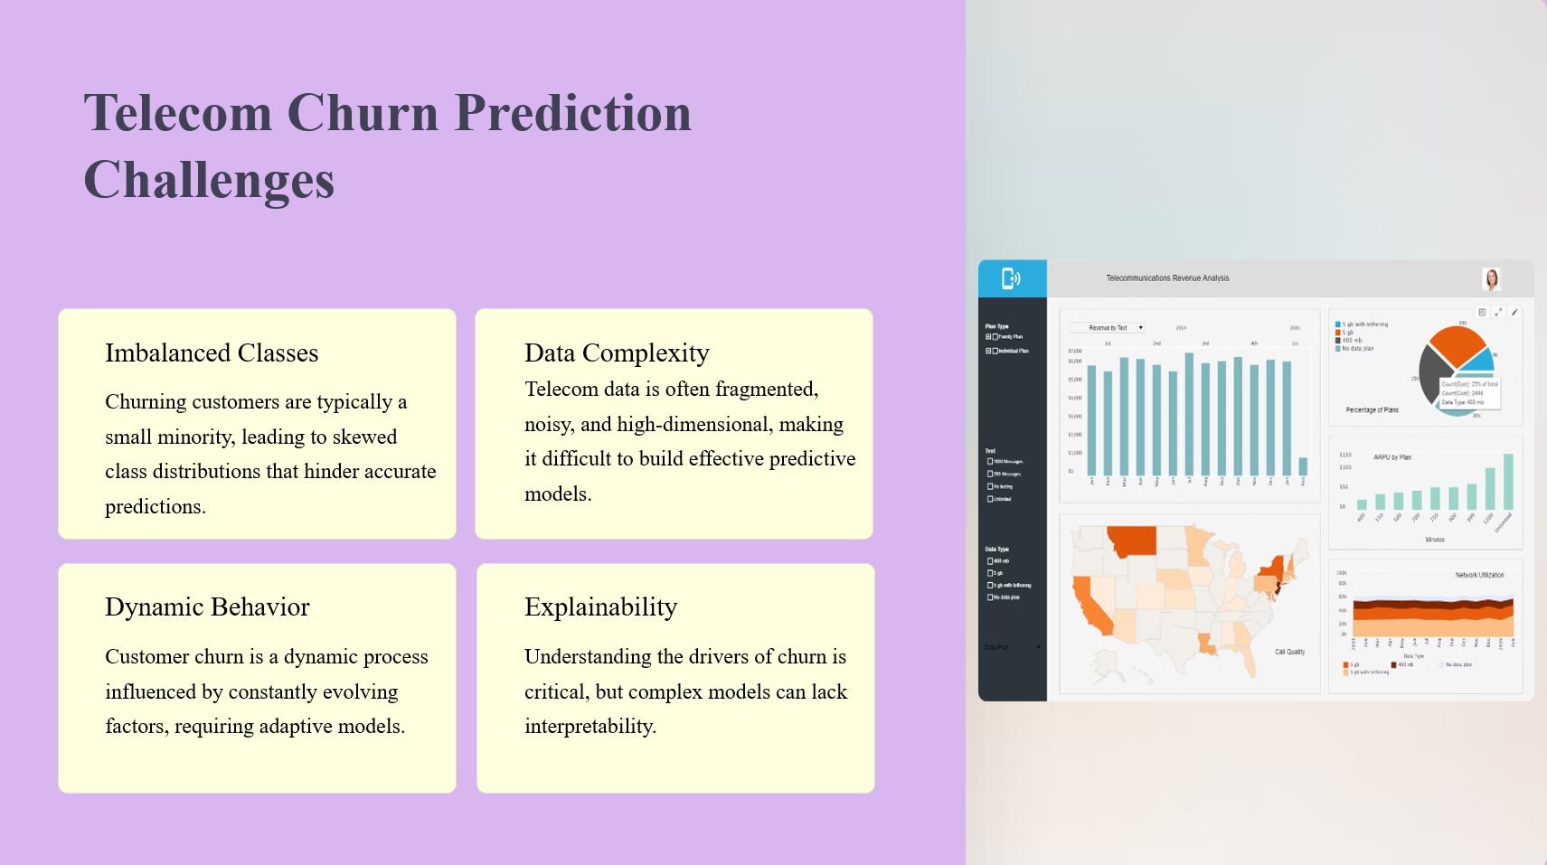

Slide 7




MILESTONES
01
02
03
04
Data Cleaning & Preprocessing
Hyperparameter
&
ROC Curves
Data Collection
Model Training

Slide 8

DATA PREPROCESSING STEPS
Convert data type of misclassified variables: Adjust variable types to correct misclassifications in the dataset.
Remove duplicate records: Eliminate duplicate entries to ensure each observation is unique.
Remove unique values: Exclude variables with constant values across the dataset as they do not contribute to modeling.
Remove zero variance variables: Discard variables with no variability as they provide no discriminatory information.

Slide 9

Outlier treatment: Use methods such as boxplot-based thresholds, standardization, or capping/flooring to handle outliers effectively.
Missing value treatment: Decide whether to remove records with few missing values, discard variables with excessive missing data, or impute missing values based on data characteristics.
Remove highly correlated variables: Exclude variables that exhibit strong linear relationships to avoid multicollinearity issues.
Multicollinearity (VIF > 5): Address multicollinearity by assessing and potentially removing variables with high Variance Inflation Factor (VIF) scores.

Slide 10
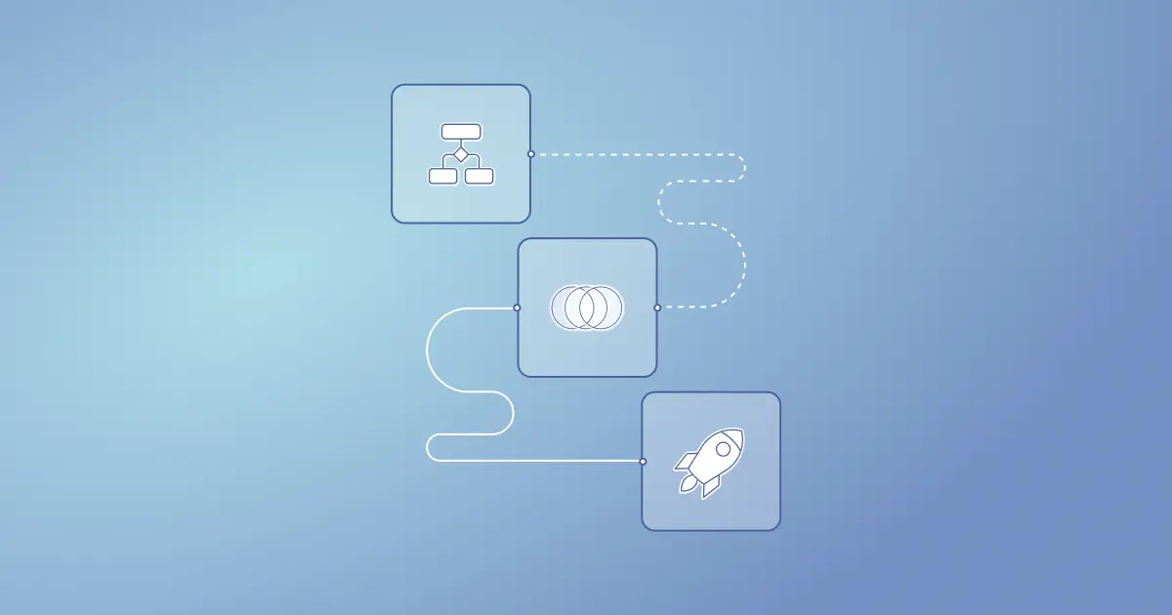
MACHINE LEARNING MODEL BUILDING
Random Forest
Decision Tree
Logistic Regression

Slide 11

RANDOM FOREST
Random Forest is a popular supervised learning algorithm used for both classification and regression. It leverages ensemble learning by combining multiple classifiers to solve complex problems and enhance model performance.
The algorithm consists of numerous decision trees built on different subsets of the dataset. It predicts the final output based on the majority vote of these trees.
By averaging predictions from multiple trees, Random Forest improves predictive accuracy. Increasing the number of trees generally leads to higher accuracy and helps prevent overfitting.

Slide 12
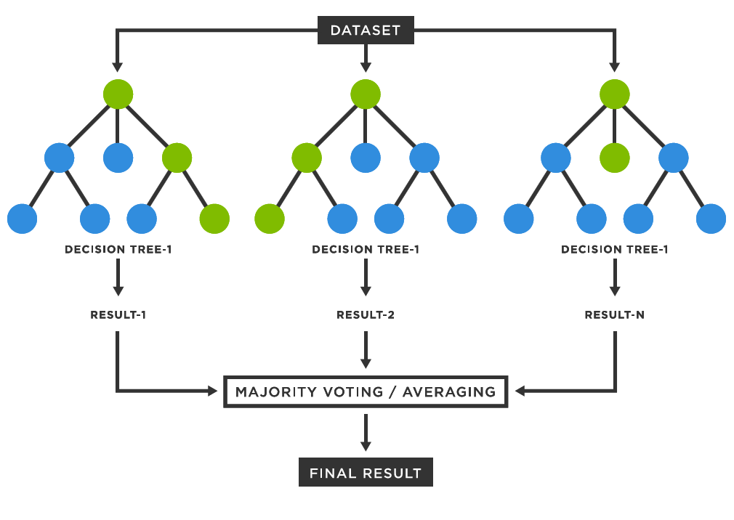
RANDOM FOREST

Slide 13
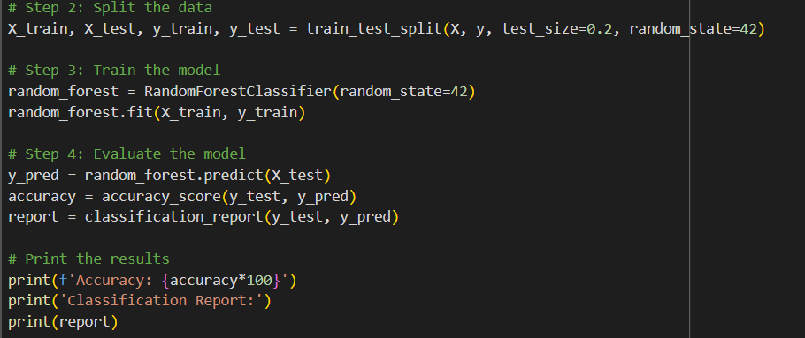
RANDOM FOREST

Slide 14
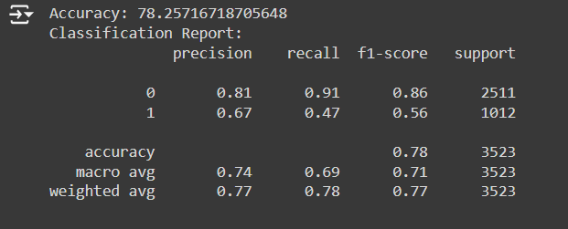
RANDOM FOREST OUTPUT

Slide 15

DECISION TREE
Decision Tree is a supervised learning technique used primarily for classification problems, though it can handle regression.
It features a tree-structured classifier with internal nodes representing dataset features, branches as decision rules, and leaf nodes as outcomes.
Decision nodes make decisions and have multiple branches, while leaf nodes represent final decisions with no further branches.
Decisions are based on the dataset's features. It visually represents all possible solutions to a problem based on given conditions.

Slide 16

DECISION TREE

Slide 17
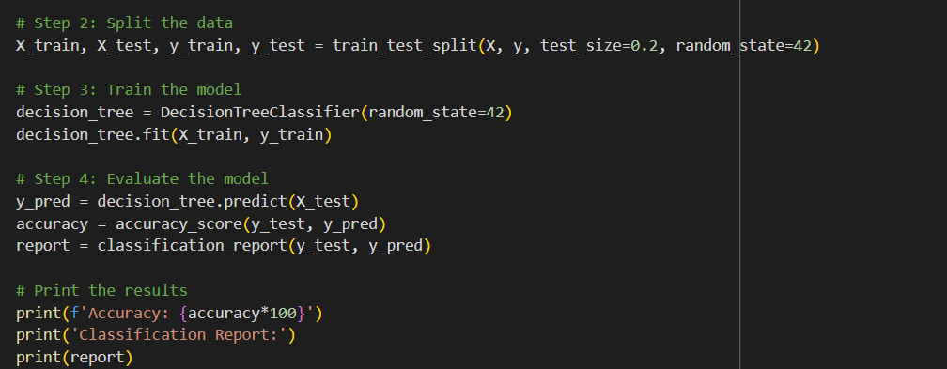
DECISION TREE

Slide 18
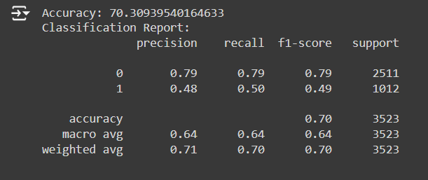
DECISION TREE OUTPUT

Slide 19

LOGISTIC REGRESSION
Logistic Regression is used for binary classification, predicting outcomes as 0 or 1 by modeling probabilities with a logistic function.
It assumes a linear relationship between predictors and the log odds of the outcome. Parameters are optimized through methods like maximum likelihood or gradient descent.
This method handles multicollinearity and is suitable for large datasets, less prone to overfitting than complex models. It's effective when relationships between predictors and outcomes are linear, requiring sufficient data for accurate predictions.

Slide 20
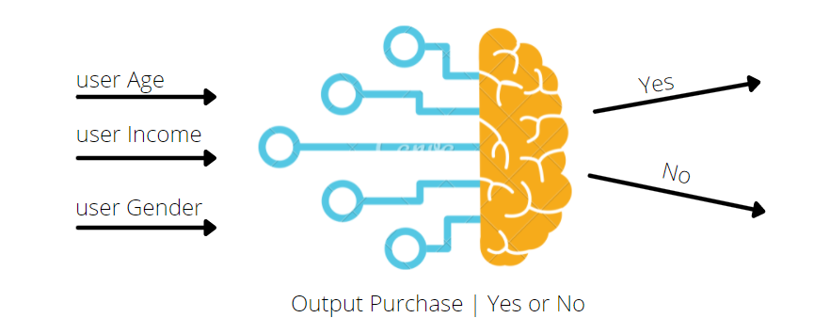
LOGISTIC REGRESSION

Slide 21
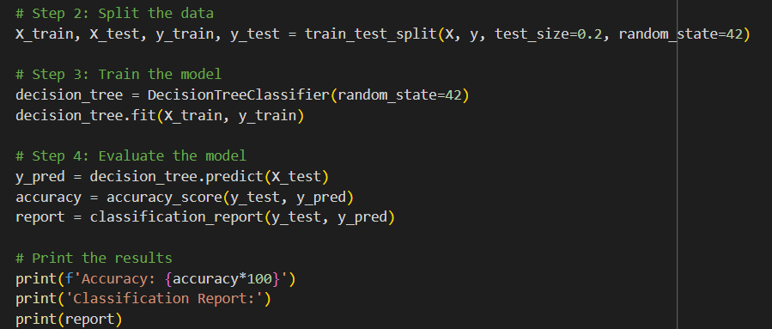
LOGISTIC REGRESSION

Slide 22
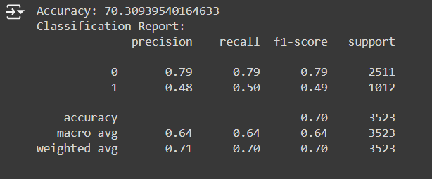
LOGISTIC REGRESSION OUTPUT

Slide 23

HYPERPARAMETER TUNING
Hyperparameter tuning is a machine learning process that involves finding the best values for a learning algorithm's hyperparameters to optimize model performance.
Hyperparameter tuning can help ensure that a model performs well and produces the best possible results

Slide 24
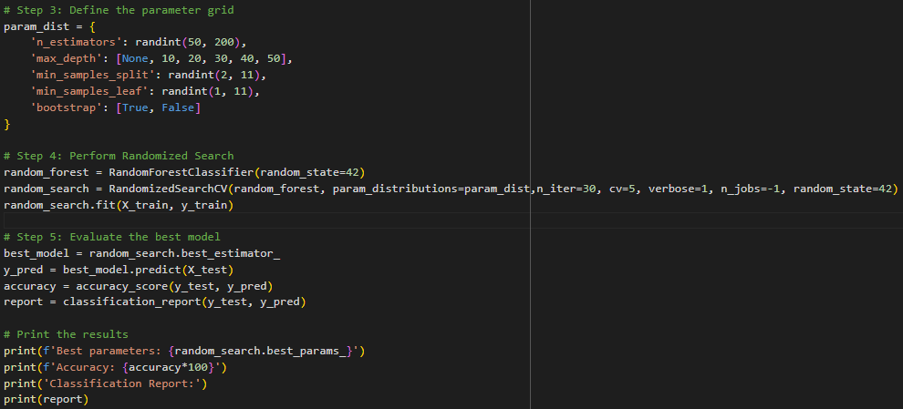
RANDOM FOREST

Slide 25
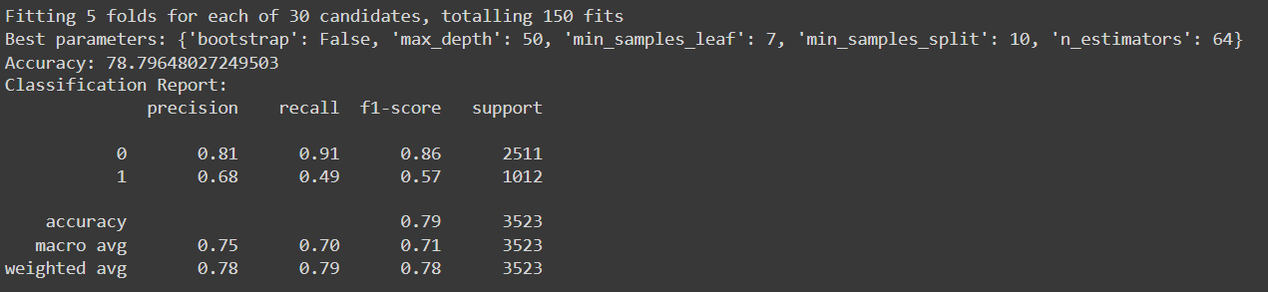
RANDOM FOREST OUTPUT:
Here is the output of Random Forest Model

Slide 26
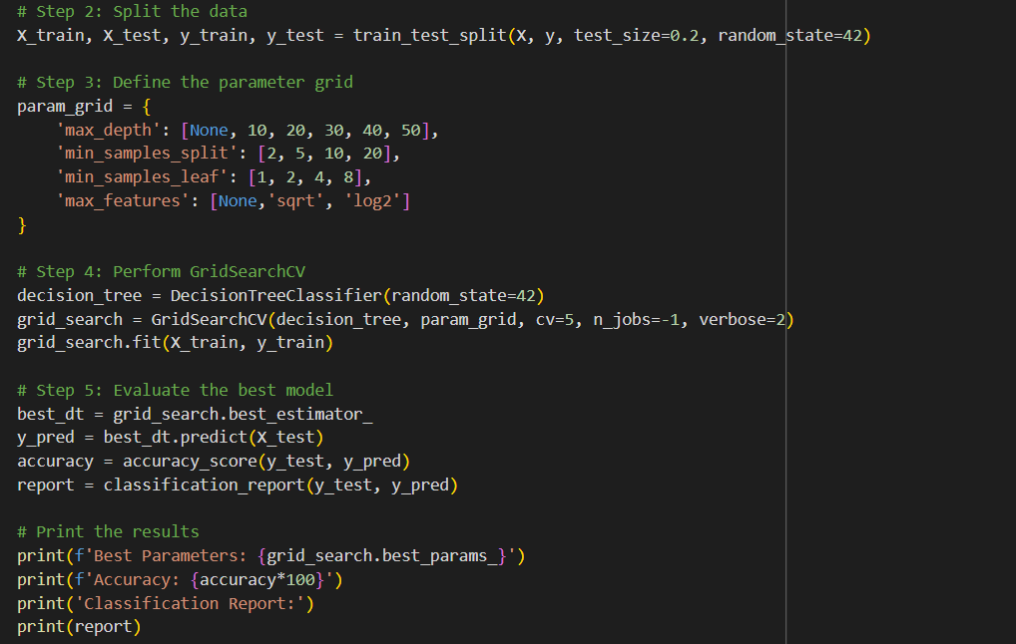
DECISION TREE

Slide 27
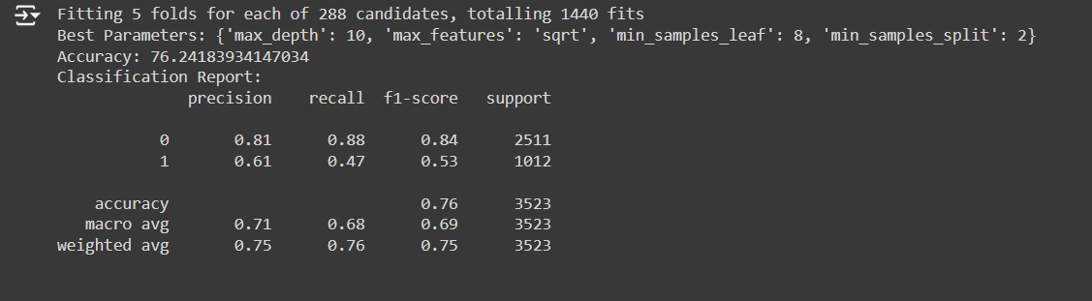
DECISION TREE OUTPUT:
Here is the output of Decision Tree Model

Slide 28
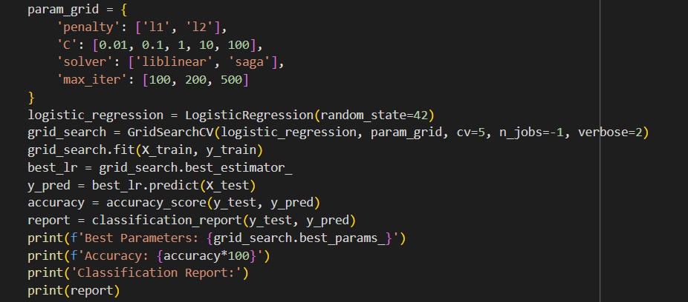
LOGISTIC REGRESSION

Slide 29
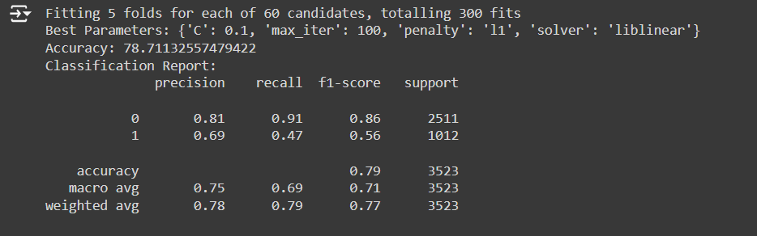
LOGISTIC REGRESSION OUTPUT:
Here is the output of Logistic Regression Model

Slide 30

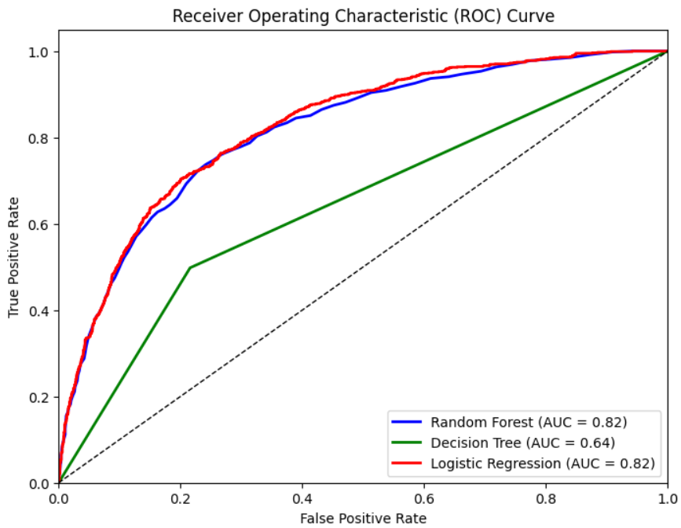
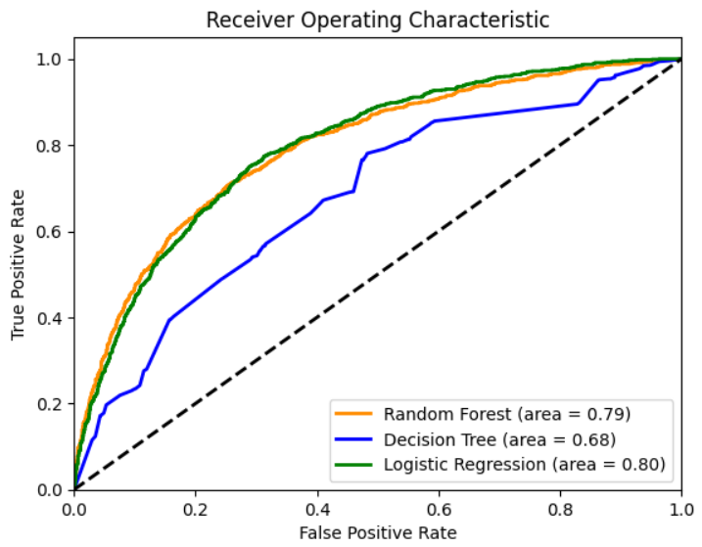
ROC CURVES
ROC curves illustrate the performance of a classification model by
plotting the true positive rate against the false positive rate. They help in selecting the optimal threshold for classification.
Before Hyperparameter Tuning After Hyperparameter Tuning

Slide 31

CONCLUSION
The telecom churn prediction project demonstrates the power of machine learning in identifying customers at risk of leaving a telecommunications service. By leveraging historical data and applying advanced predictive modeling techniques, we can gain valuable insights into the factors driving customer churn and proactively address them.

